Slide 1

D. Y. PATIL COLLEGE OF ENGINEERING, AKURDI, PUNE-44
Department of Artificial Intelligence & Data Science
BE Project Stage - II (A.Y. 2023-24 SEM II)
Presentation On
Automatic Detection of Pneumonia using Deep Learning Techniques
Team Members Co-Guide Guide Siddhant Sonawane Mrs. Supriya Patil Dr. V.G. Kottawar
Mohammed Kaif Mirza
Doshant Rahangdale
Jaydatta Bade

Slide 2
Abstract
Pneumonia detection presents a persistent challenge in healthcare, necessitating accurate and interpretable diagnostic systems for timely interventions.
Drawing from an extensive literature survey encompassing textural feature extraction methods, CNN architectures, pretrained models, and unsupervised GAN-based approaches, this project aims to redefine pneumonia detection.
Our objectives revolve around integrating state-of-the-art deep learning methodologies with attention mechanisms and explainable AI to augment feature extraction accuracy from chest X-ray images while ensuring transparent diagnostic outcomes.
Validation and experimentation endeavors seek to validate these enhancements, demonstrating superior accuracy and fostering trust in clinical decision-making.

Slide 3
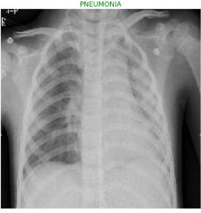
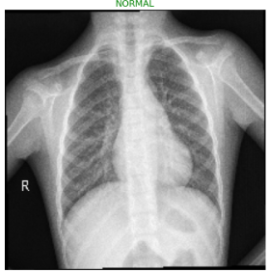
Introduction
"Automatic Detection of Pneumonia using Deep Learning Techniques"
Pneumonia remains a critical concern in healthcare, demanding accurate and transparent detection methodologies.
Current pneumonia detection methods often lack the necessary interpretability, hindering their integration into clinical practice and decision-making.
By leveraging advanced technologies, our goal is to not only enhance accuracy but also ensure interpretability and transparency in diagnostic systems.
Our project focuses on bridging this gap by infusing deep learning methodologies with attention mechanisms and explainable AI, ensuring not only high accuracy but also transparent and interpretable diagnostic outcomes.

Slide 4
Problem Statement
Challenges:
Traditional methods rely on manual interpretation.
Prone to human error and variability.
Need for automation and interpretability.
Objective:
Develop an automated, accurate, and interpretable diagnostic tool.

Slide 5
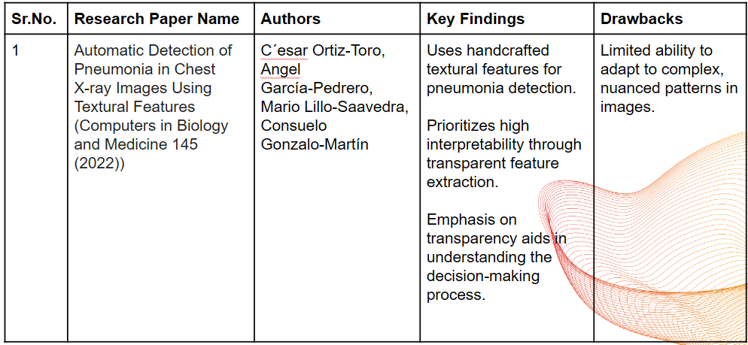
Literature Review

Slide 6
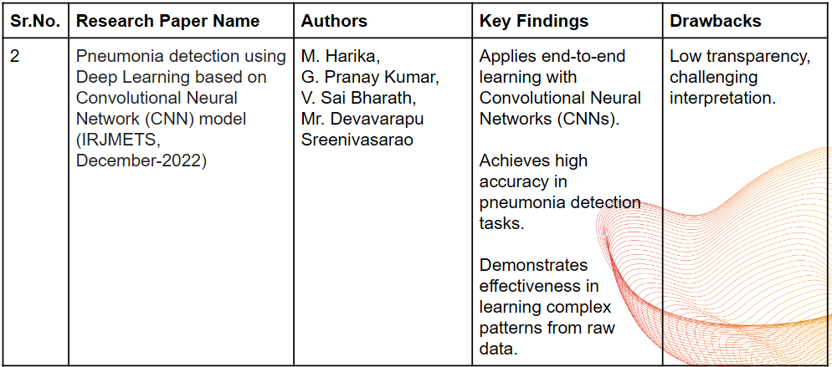
Literature Review

Slide 7
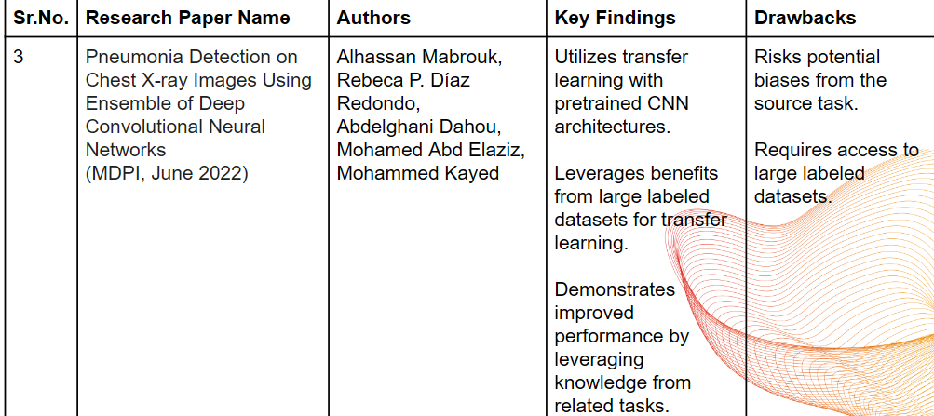
Literature Review

Slide 8
Literature Review
Existing Systems:
Manual interpretation by radiologists.
Early computer-aided detection (CAD) systems.
Modern deep learning-based approaches.
Limitations:
Lack of transparency in decision-making.
Inconsistent accuracy across different datasets.
Limited interpretability of results.

Slide 9
Software Development Process
Research
Finding the correct approach
Architecture and Design selection
Data Collection
Image Preprocessing
Model Selection
Model Training
Hyperparameter Tuning and Optimization
Testing and Validation
Analysis
Deployment

Slide 10
Data Collection and Preprocessing
Dataset:
Source: Kaggle Chest X-ray dataset.
Categories: Pneumonia and Normal.
Total Images: 5,863.
Data Preprocessing
Steps:
  Image Normalization: Resize and normalize pixel values.
  Data Augmentation: Apply transformations (rotation, flip, zoom) to increase dataset diversity.

Slide 11
Proposed Solution
CNN with Attention Mechanism:
Attention mechanism is a component used in machine learning models, particularly in natural language processing and computer vision. It enables the model to focus on specific parts of the input sequence or image when making predictions.
Explainable AI (XAI) using LIME:
Explainable AI (XAI) refers to the development of artificial intelligence systems that can provide understandable and interpretable explanations for their decisions or outputs. It aims to make AI models more transparent and trustworthy.

Slide 12
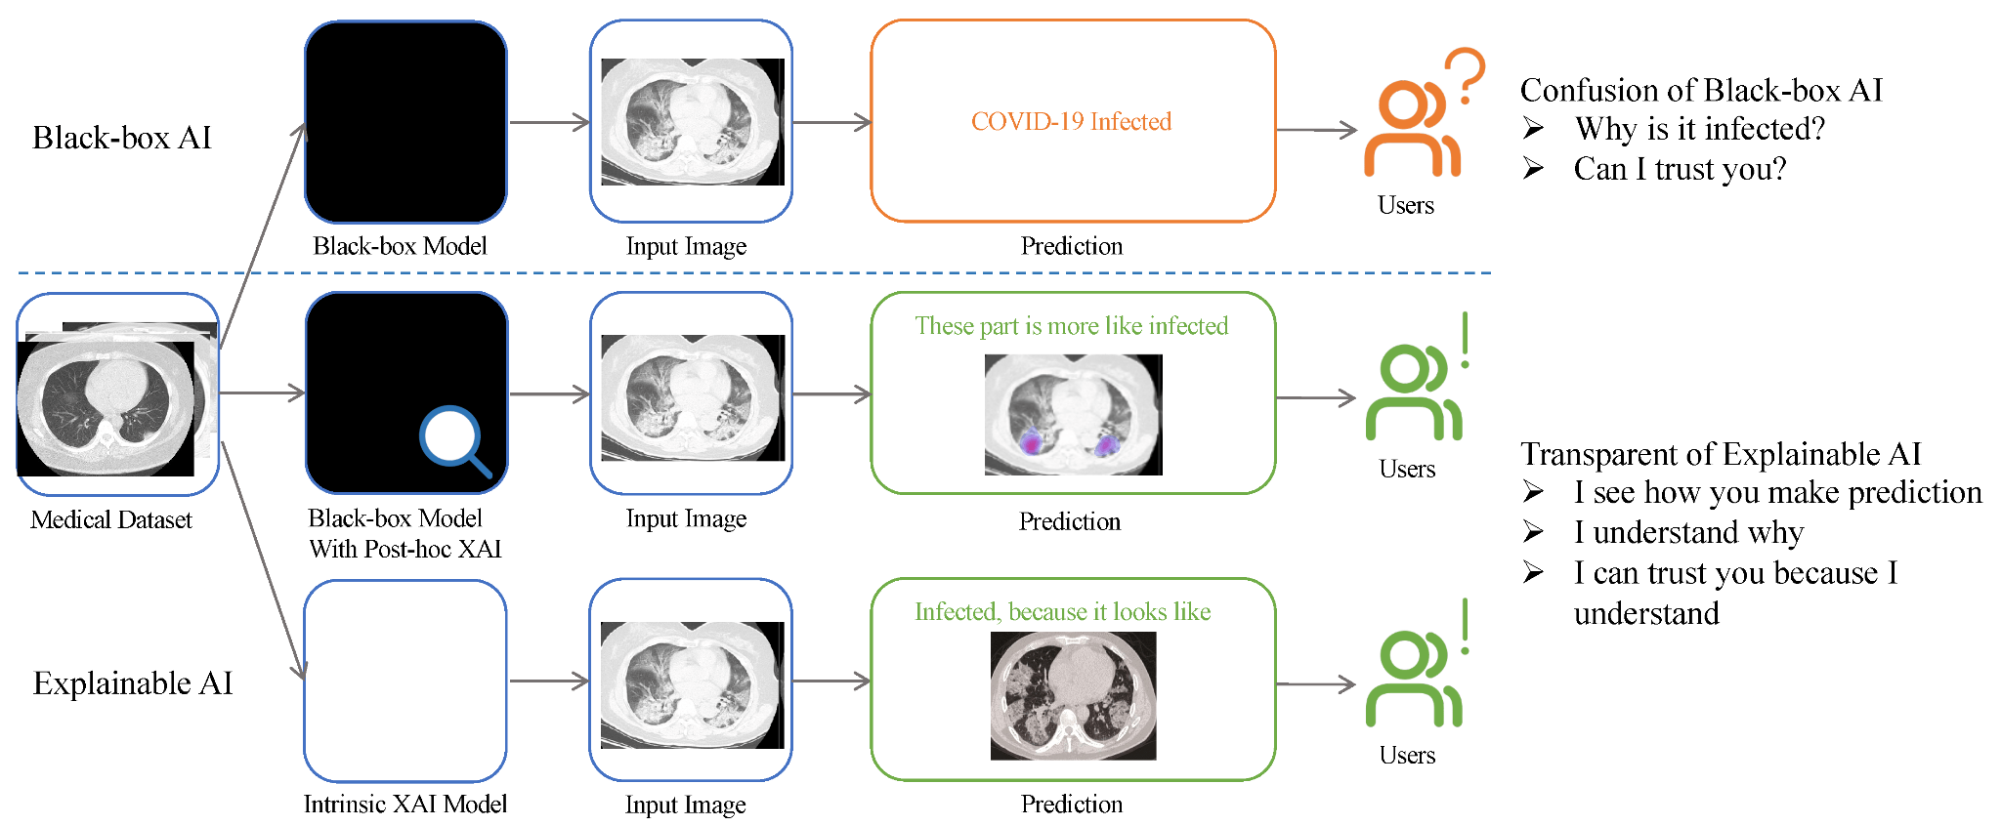
Why Explainable AI

Slide 13
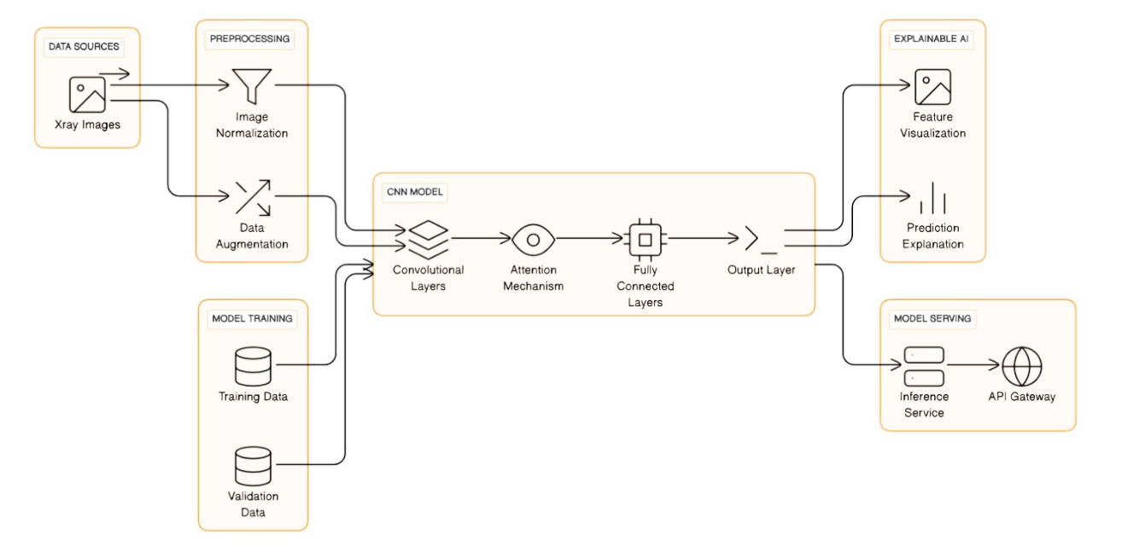
Architectural / System Design

Slide 14
Model Architecture
Components:
  Convolutional Layers: Extract features from input images.
  Attention Mechanism: Focus on the most relevant regions of the image.
  Fully Connected Layers: Perform high-level reasoning.
  Output Layer: Predict the presence or absence of pneumonia.
XAI - Provides local explanations for individual predictions.

Slide 15
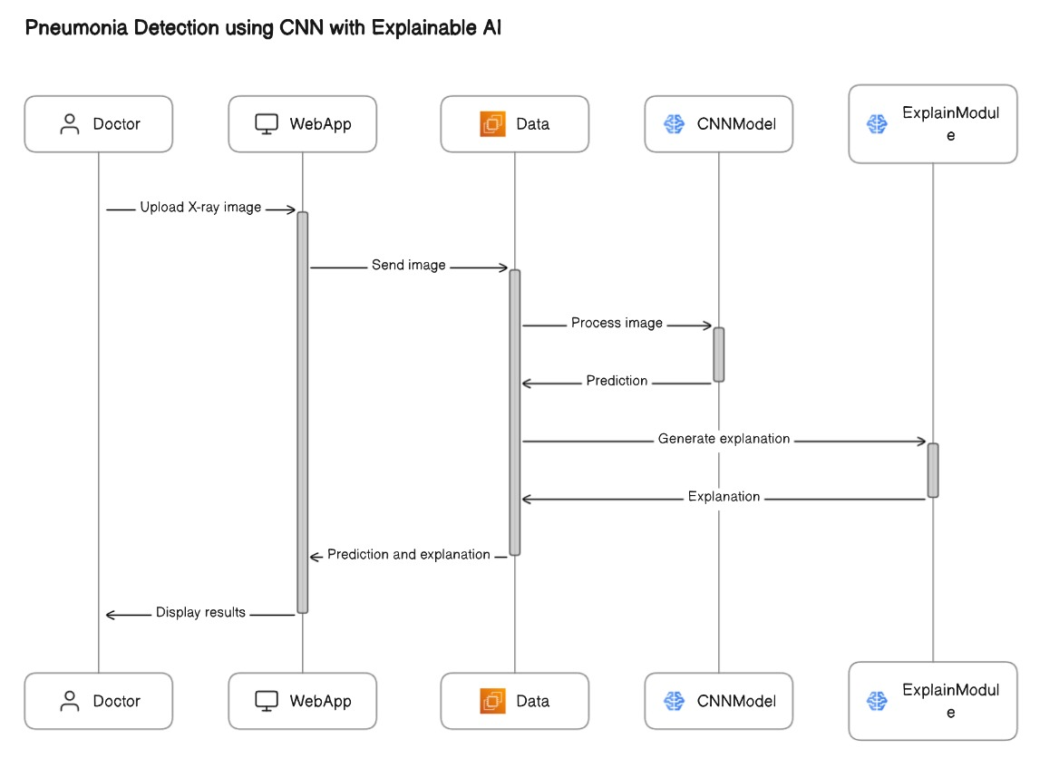
Sequence Diagram

Slide 16
Methodology
Integration of Attention Mechanisms: Incorporating attention mechanisms within deep learning architectures for refined feature extraction from chest X-ray images.
Explainable AI Integration: Utilizing explainable AI techniques to ensure transparency and interpretability of diagnostic outcomes.
Enhanced Accuracy & Interpretability: Aimed at achieving superior accuracy rates while providing transparent insights into diagnostic predictions crucial for clinical acceptance.

Slide 17
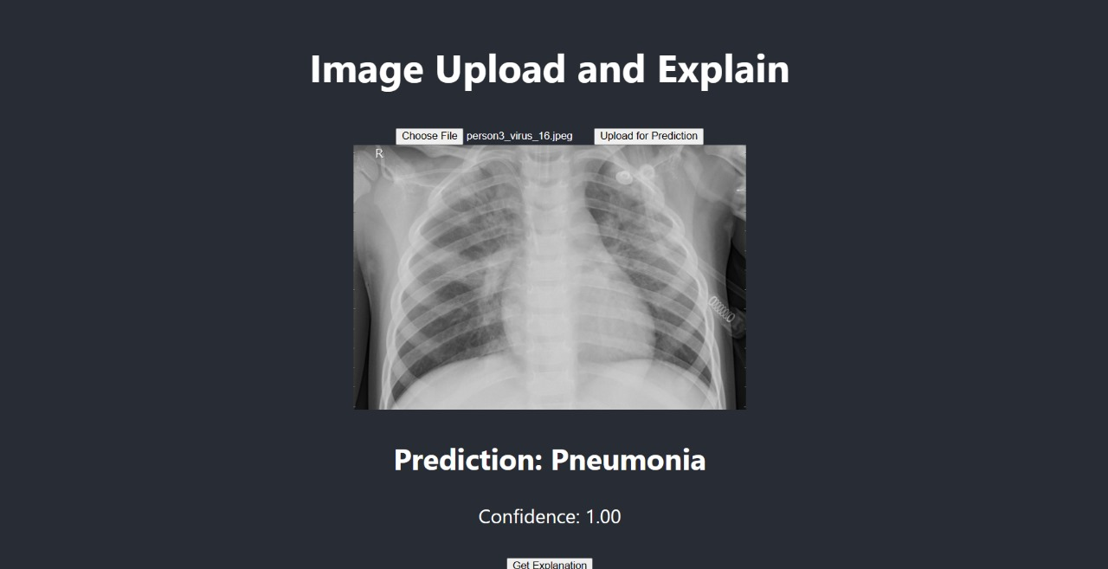
Implementation & Result

Slide 18
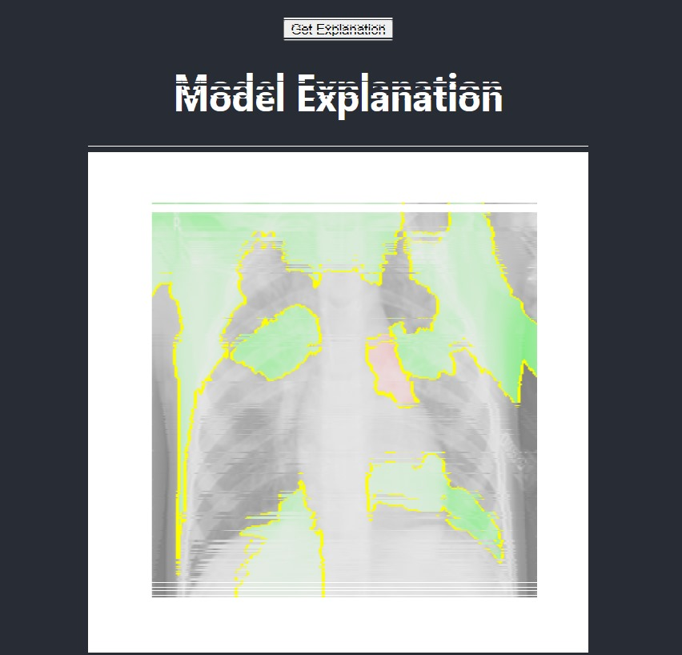
Explainable AI Implementation

Slide 19
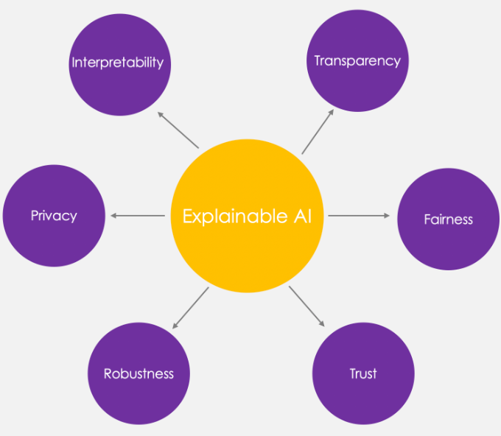
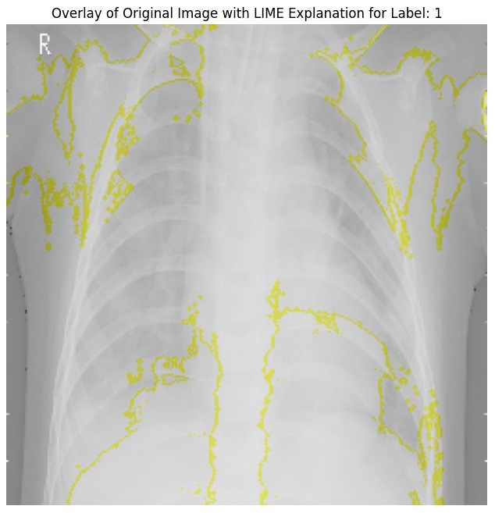
Explainable AI Techniques
LIME (Local Interpretable Model-agnostic Explanations):
  Provides local explanations for individual predictions.
Benefits:
  Transparency in model decisions.
  Helps radiologists understand the reasoning behind predictions.

Slide 20
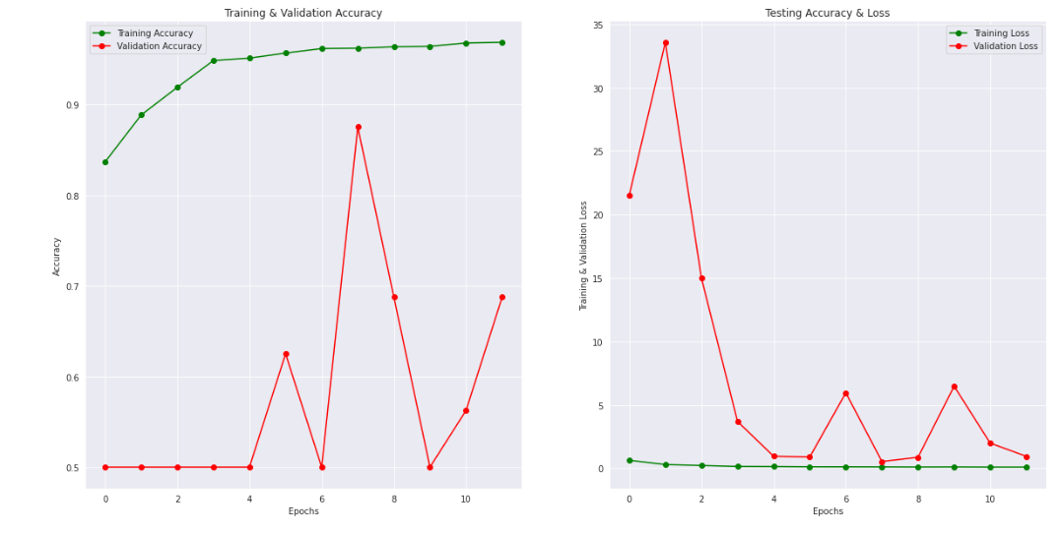
Testing & Evaluation

Slide 21
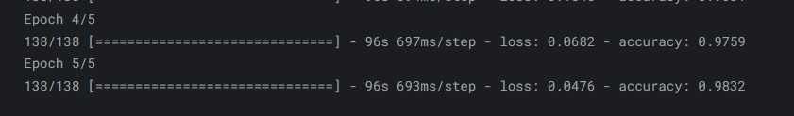
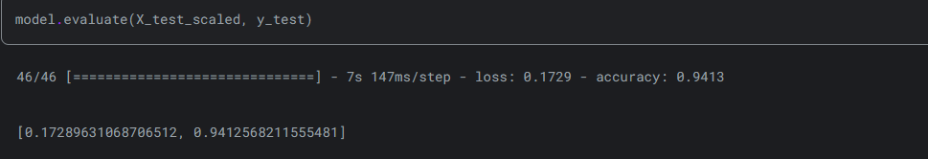
Experimental Results
Model - CNN with Attention Block
Train_Accuracy - 98%
Test Accuracy: 94%

Slide 22
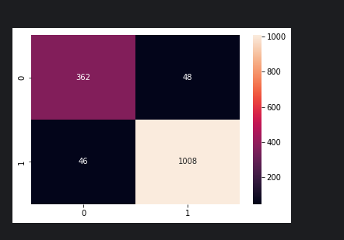
Experimental Results
Confusion Matrix
True positive (362)
True negative (1008)
False positive (48)
False negative (46)

Slide 23
Challenges and Limitations
Challenges:
  Data quality issues (e.g., varying image quality).
  Overfitting during the training phase.
Limitations:
  Occurrence of false negatives.
  Need for more real-world validation and diverse datasets.

Slide 24
Conclusion
Achievements:
Improved diagnostic accuracy for pneumonia detection.
Developed a transparent and interpretable AI model.
Impact:
Potential benefits in clinical settings.
Supports radiologists in making informed decisions.

Slide 25
Thank You !!!

